Slide 1
32-bit RISC-V CPU Design
Review and discussion session – August 13th 2023
32-bit RISC-V Core specifications:
5 stage pipelined processor
I-M-F Extensions from RISC-V standard ISA
“F” Extension can be considered both “Fixed-Point” and “Floating-Point”
Approximate Multiplication Unit
Controlled by a Special Purpose Register (CSR)
7-Error control bits (128 different accuracies)

Slide 2
CPU Block Diagram:
Control Unit
Fetch Unit
PC
IF
Instruction Decoder
ID
EX
LSU
Memory Interface
ALU
Immediate
Generator
MEM
Memory Interface
MUL/DIV
Instruction Memory
Integer
Register File
Fixed Point
Register File
Data Memory
FPU
immediate
Address Generator
PC
Hazard Detection & Forwarding Unit

Slide 3
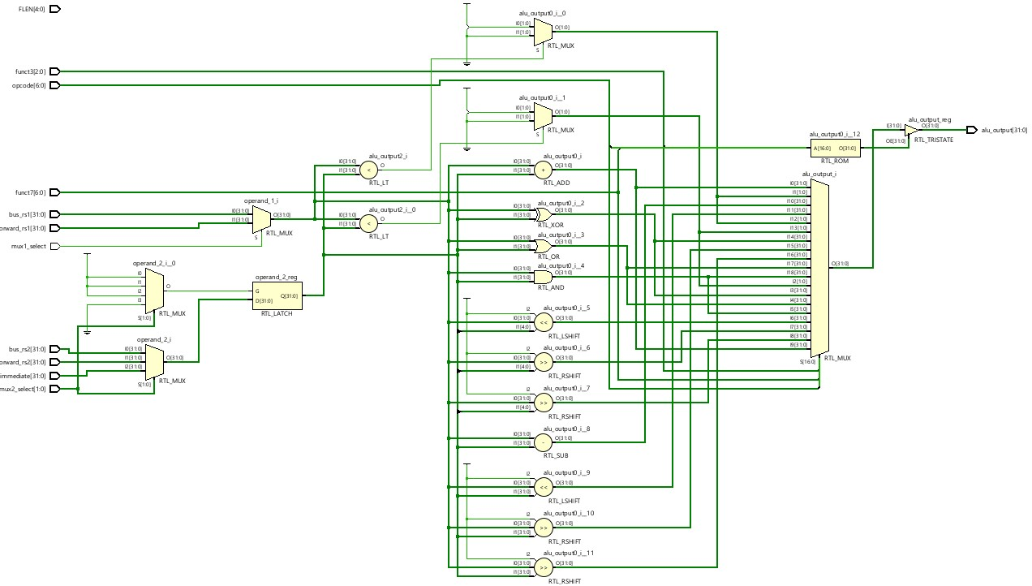
Arithmetic Logic Unit:
Note: Images are taken from RTL Elaborated Design in Xilinx Vivado after synthesis process

Slide 4
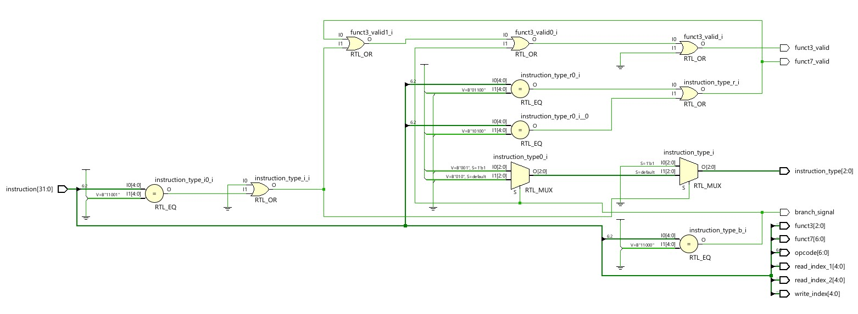
Instruction Decoder:
Note: Images are taken from RTL Elaborated Design in Xilinx Vivado after synthesis process

Slide 5
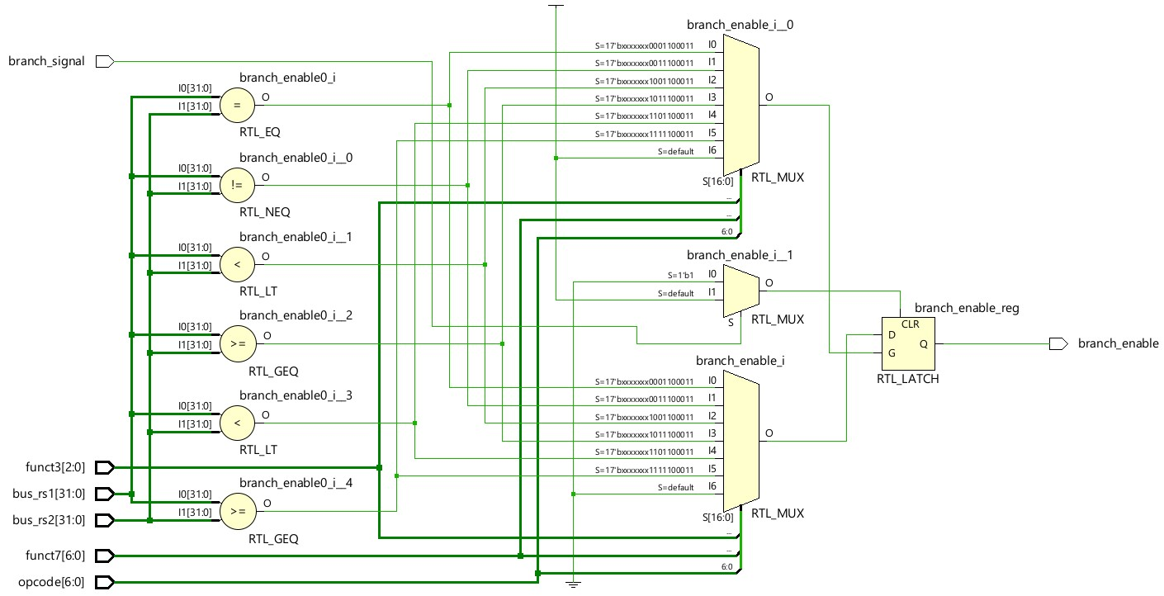
Branch Unit:
Note: Images are taken from RTL Elaborated Design in Xilinx Vivado after synthesis process

Slide 6
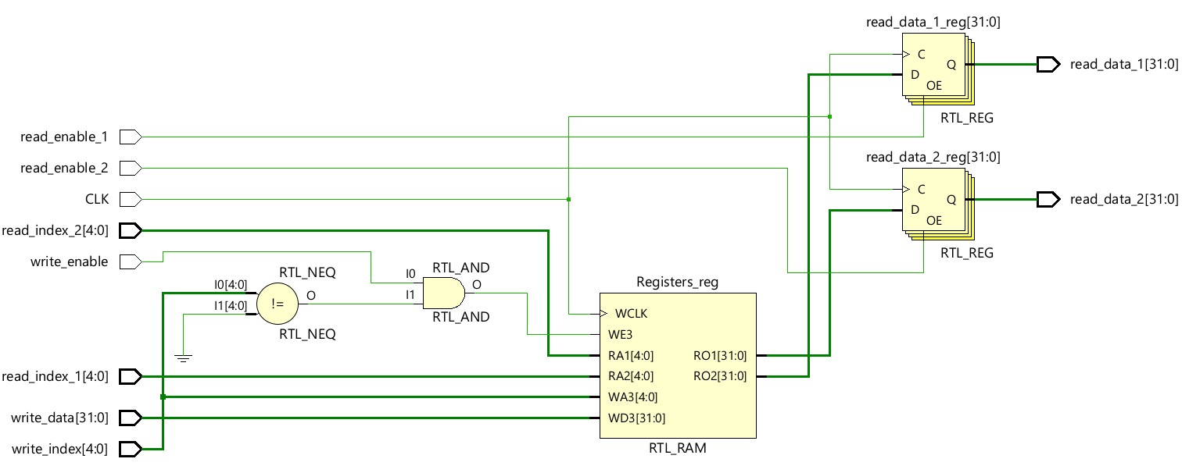
Register File:
Note: Images are taken from RTL Elaborated Design in Xilinx Vivado after synthesis process

Slide 7
To do list:
Phase 1:
Design Control, Hazard and Forwarding Unit.
Create the pipelined Datapath with the designed modules.
Complete RV32I extension and test with GCC compiler toolchain in Linux.
By the end of phase 1, we have a processor which supports GCC and RV32I instructions.
Phase 2:
Pipeline Multiplier Unit and add M-Extension Instructions.
Add DIV instruction support to the core.
Add FPU to the execution unit.
Note: Design must be modular and hierarchical so that FPU could be changed between “Fixed-Point” and “Floating-Point” formats.

